Slide 1
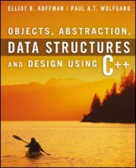
Welcome to
CS 235 Data Structures
C++ Primer, P.7-9 (05)

Slide 2
Tip #05: Local Declarations
Should I declare locals in the middle of a function or at the top?
First, declare an object near first use.
Improves readability by making it easy to find the definition.
Easier to give useful initial value.
Second, if you don’t have enough information to initialize an object until halfway down the function, you should create it halfway down the function when it can be initialized correctly.
Initializing an object to an “empty” value at the top and then “assigning” it later results in a runtime performance hit.
Building an object correctly is faster than building it incorrectly and remodeling it later. (e.g., a factor of 350% speed hit for simple classes like String.)
Bottom line: Locals should be declared near their first use and preferably initialized to a meaningful value.

Slide 3
l-values vs. r-values
x = y;
l-value
r-value
address
contents
A region of memory that can be examined and modified (if not const).
Any expression that has a value but cannot have a value assigned to it.
Memory is allocated and assigned an address for every l-value at compile time.
The contents of an r-value is NOT known until runtime.
l-value addresses are not moveable.
r-values addresses are moveable. (l-values are often converted to r-values.)
Function parameters are local l-values.
Function arguments are r-values or l-values.
int Func(int x) { ... }
x = Func(5 * 4) + Func(dog)

Slide 4
Call by Value
// Function definition
void swap(int x, int y)
{
int temp = x;
x = y;
y = temp;
}
// Function call
int main()
{
int a = 10;
int b = 20;
swap(a, b);
cout << "a = " << a << endl;
cout << "b = " << b << endl;
return 0;
}
When you define a function prototype or definition, you define the parameter variables (l-values) that will be passed argument values when the function is called.
When you call a function, arguments (r-valves or l-values) are evaluated and passed (by value) to the function parameters.
A formal parameter in a function definition is an l-value.
An actual parameter (argument) is the value passed to the function parameter. (l-value or r-value)
The arguments a and b will NOT be swapped.

Slide 5
Call by Value (Pointer)
// Function definition
void swap(int* x, int* y)
{
int temp = *x;
*x = *y;
*y = temp;
}
// Function call
int main()
{
int a = 10;
int b = 20;
swap(&a, &b);
cout << "a = " << a << endl;
cout << "b = " << b << endl;
return 0;
}
When you define a function prototype or definition, you define the parameter variables (l-values) that will be passed argument values when the function is called.
When you call a function, arguments (r-valves or l-values) are evaluated and passed (by value) to the function parameters.
The variable x points to the calling function's argument.
The value pointed to by y is modified.
A pointer parameter (l-value) is passed (by value) an address specified in the calling function argument.
The function can modify the dereferenced value pointed to by the parameter.
The arguments a and b will be swapped.

Slide 6
Call by Reference
// Function definition
void swap(int& x, int& y)
{
int temp = x;
x = y;
y = temp;
}
// Function call
int main()
{
int a = 10;
int b = 20;
swap(a, b);
cout << "a = " << a << endl;
cout << "b = " << b << endl;
return 0;
}
When you define a function prototype or definition, you define the parameter variables (l-values) that will be passed argument values when the function is called.
When you call a function, arguments (r-valves or l-values) are evaluated and passed (by value) to the function parameters.
The variable x references (points to) the calling function's argument.
The variable y is NOT modified, but rather what y references (points to) in the calling function's argument list.
Call by reference means a reference (implied pointer) to the argument object is passed to the function parameter (under the hood).
Note: A call by reference argument CAN NOT be an r-value.
The arguments a and b will be swapped.

Slide 7
Call by Reference
// Function definition
void swap(int& x, int& y)
{
int temp = x;
x = y;
y = temp;
}
// Function call
int main()
{
int a = 10;
int b = 20;
swap(10, 20);
cout << "a = " << a << endl;
cout << "b = " << b << endl;
return 0;
}
When you define a function prototype or definition, you define the parameter variables (l-values) that will be passed argument values when the function is called.
When you call a function, arguments (r-valves or l-values) are evaluated and passed (by value) to the function parameters.
Reference parameters must be passed l-value argument values.
The arguments 10 and 20 are r-values.
Call by reference means a reference (implied pointer) to the argument object is passed to the function parameter (under the hood).
Note: A call by reference argument CAN NOT be an r-value.
r-value cannot be converted to a reference.
**will not compile**

Slide 8
Pointers
Pointers

Slide 9
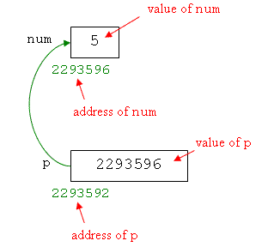
What are Pointers?
A pointer variable (commonly referred to a "pointer") is a variable that holds a memory address.
A reference is a variable alias, that is, another name for an already existing l-value variable.
A pointer is dereferenced with the unary dereferencing operator (*) to access the contents of the memory location it points to.
The unary address-of operator (&) returns an r-value address of its l-value argument.
int num = 5;
int* p = &num;
cout << endl << num;
cout << endl << *p;
cout << endl << p;
cout << endl << &num;

Slide 10
Array Names Act Like Pointers
An array is a sequence of like items (same data types.)
Pointers and arrays support the same set of operations.
However, pointers can be assigned new addresses (modifiable l-values), while arrays cannot (non-modifiable r-values).
Brackets ([ ] operator) specify the index of an element in an array.
Brackets are a dereferencing operator known as the "index operator."
Brackets dereference the variable just (as * does) by adding the number between brackets (× size of data type) to the address being dereferenced.
a[5] = 0; // a [offset of 5] = 0
*(a+5) = 0; // pointed to by (a+5) = 0
The above two expressions are equivalent, regardless if a is a pointer or an array name.
An array name can be used just like a pointer to its first element.

Slide 11
Pointers to Pointers
Pointers to pointers.
C++ allows the use of pointers that point to pointers, and these in turn, point to data (or even to other pointers).
The syntax simply requires an asterisk (*) for each level of indirection in the declaration of the pointer.
char a; char* b; char** c; a = 'z'; b = &a; c = &b;
c is of type char** and a value of 8092
*c is of type char* and a value of 7230
**c is of type char and a value of 'z'

Slide 12
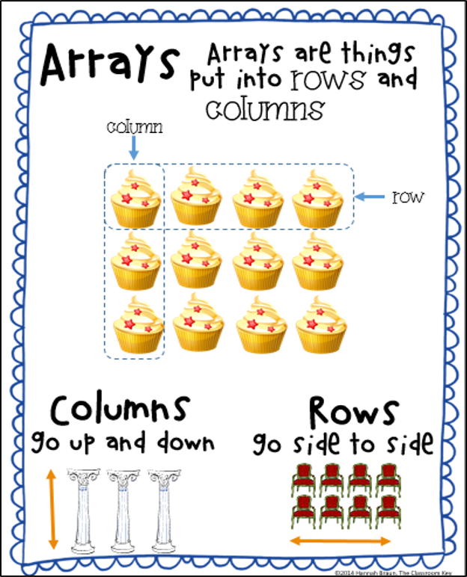
P.7 Arrays and C Strings
Array-Pointer Equivalence
Array Arguments
String Literals and C Strings
Multidimensional Arrays
P.7 Arrays and C Strings

Slide 13
Arrays, Pointers, Pointer Variables
An array is a sequence (in memory) of like items.
In C and C++, arrays are NOT data types.
The static array size must be explicit at compile time.
Zero based subscripts.
No compile-time or run-time limit checking.
Pointers are arrays, array names are pointers, but array names are NOT pointer variables.
char a[6];
Requests memory for 6 characters, pointed to by the name “a”.
The array name “a” is known only at compile time!
char* p;
“p” is a pointer variable and can point to any char (or array of chars).
Example:
a:
h
e
l
l
o
\0
char a[6] = "hello";
char *p = "world";
p:
w
o
r
l
d
\0

Slide 14
Dynamic Objects
When any C++ object is created
Storage must be allocated for the object (static, stack, or heap).
The constructor is called to initialize that storage.
The destructor is called to release object storage.
Stack
Dynamic Data (Heap)
Static data (global variables)
Program Code
With local objects, the compiler decides
where the object is stored (stack),
when the object is constructed (declaration), and
when the object is destroyed (goes out of scope).
With dynamic objects, the programmer decides
where the object is stored (heap),
when the object is constructed (new operator), and
when the object is destroyed (delete operator).
Pointers are always used to refer to dynamically created objects.
{
int size = 4;
int* myInts = new int[size];
}
size:
4
myInts:
size

Slide 15
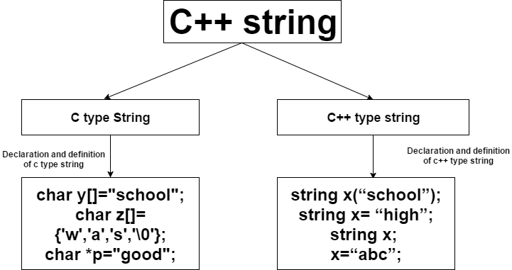
P.8 The string Class
Strings Are Really Templates
P.8 The string Class

Slide 16
Template Classes
A C++ template is literally a template or blueprint for creating a generic class or function of a specified type.
A template is not a class.
Using C++ templates avoids having to write nearly identical classes (int, float, etc.), but results in compiled code that is mostly as if we had written each version separately.
A C++ template uses "Instantiation-style polymorphism.
For example, the template MyClass<T> isn't really a generic class that can be compiled to code.
Only the result of instantiation of the template can be compiled.
The C++ string class is an instantiation of the basic_string class template that uses char (i.e., bytes) as its character type.
Strings are objects that represent sequences of characters.
typedef basic_string<char> string;

Slide 17
Strings vs Character Arrays
Character arrays
Size allocated statically.
More memory cannot be allocated at run time.
Unused allocated memory is wasted.
Strings
Size allocated dynamically.
Memory allocated at run time on demand.
Memory is pre-allocated, no memory is wasted.
Threat of array decay (loss of type and dimensions when passing an array into function by value or pointer).
As strings are represented as objects, no array decay occurs.
std:: string slower with object construction.
Implementations are fast.
String class functions:
Input functions (3),
Capacity functions (3),
Iterator functions (4),
Manipulating functions (2),
and more…
No inbuilt functions to manipulate strings. (string.h library w/strcpy, strcat, strlen, strcmp, …)

Slide 18
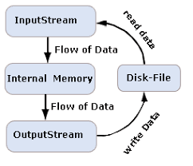
P.9 Input / Output Using Streams
Console Input / Output
Input Streams
Output Streams
Formatting Output Using I/O Manipulators
File Streams
openmode
String Streams
P.9 Input / Output Using Streams

Slide 19
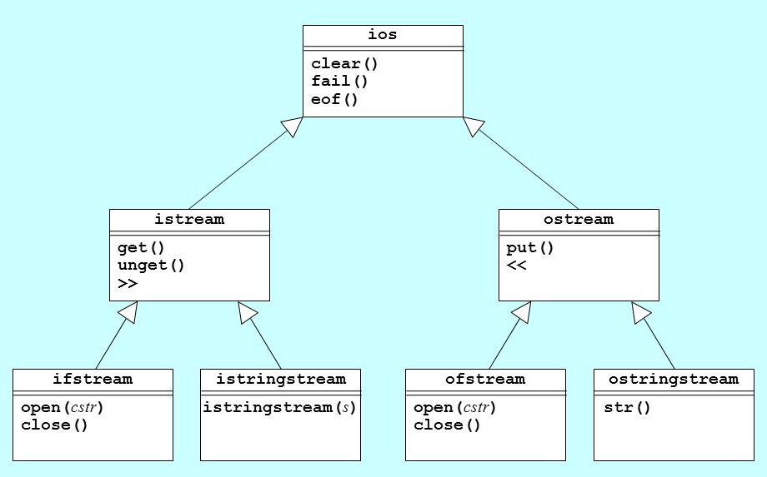
Stream Class Hierarchy
Input
Output

Slide 20
Text File I/O Streams
#include <iostream>
#include <fstream>
#include <string>
using namespace std;
// reading a text file
int main (int argc, char* argv[])
{
string line;
ifstream in("example.txt");
if (in.is_open())
{
while (getline(in, line))
{
cout << line << endl;
}
in.close();
}
else cout << "Unable to open file";
return 0;
}
#include <iostream>
#include <fstream>
using namespace std;
// writing a text file
int main (int argc, char* argv[])
{
ofstream out("example.txt");
if (out.is_open())
{
out << "This is line 1" << endl;
out << "This is line 2" << endl;
out.close();
}
else cout << "Unable to open file";
return 0;
}
out
out
in
in
out
out
in
out
in

Slide 21
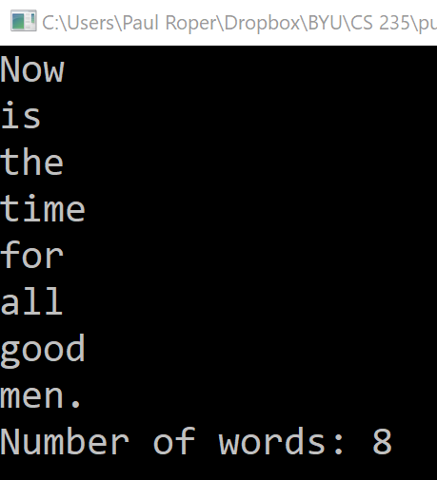
String Streams
#include <iostream>
#include <sstream>
using namespace std;
int countWords(string str)
{
stringstream ss(str); // Used for breaking words
string word; // to store individual words
int count = 0;
while (ss >> word)
{
count++;
cout << word << endl;
}
return count;
}
int main()
{
string str = "Now is the time for all good men.";
cout << "Number of words: " << countWords(str);
return 0;
}

Slide 22
Supplemental Slides

Slide 23
C++ Streams
A stream is an entity where a program can either insert or extract characters.
Abstracts character I/O operations on sequential media such as the screen, the keyboard, or a file.
The standard input stream by default is the keyboard and the istream object defined to access it is cin.
The standard output stream by default is the screen and the ostream object defined to access it is cout.
File I/O classes are derived directly or indirectly from the classes istream and ostream:
ofstream: Stream class to write on files
ifstream: Stream class to read from files
fstream: Stream class to both read and write from/to files.
File streams associate streams with physical files.

Slide 24
Input Streams
An input stream is a sequence of characters.
The class istream defines the extraction operator (>>) for primitive data types.
Input comes from input console, input file, or network socket.
Breaks input into groups of characters separated by spaces.
Upon error, error flag is set and the stream freezes.
Flush input line after insertion error.
int var;
cin >> var;
if (cin.bad()) cin.ignore(numeric_limits<int>::max(), '\n');
Function getline (from header <string>) reads whole line.
istream& getline(istream&, string&, char delim = '\n');

Slide 25
Output Streams
An output stream is a sequence of characters that can be displayed on the console, written to an output file, or written to a network socket.
The class ostream defines the insertion operator (<<) for primitive types.
Type | Processing
char | Character is output.
string | The sequence of characters in the string is output.
int, short, long | The integral value is converted to decimal and characters are output. (Leading zeros are suppressed, preceded by "-" if negative.)
float, double, long double | The floating-point value is converted to a decimal representation and output. (Default is 6 digits, numbers between 10-4 and 106 are output in fixed format, otherwise scientific format.)

Slide 26
State of Streams
The steam superclass ios_base maintains a data member to describe the states of the stream, which is a bitmask of the type iostate. The flags are:
eofbit: set when an input operation reaches end-of-file.
failbit: The last input operation failed to read the expected characters or output operation failed to write the expected characters, e.g., getline() reads n characters without reaching delimiter character.
badbit: serious error due to failure of an IO operation (e.g. file read/write error) or stream buffer.
goodbit: Absence of above error with value of 0.
These flags are defined as public static members in ios_base. They can be accessed member functions of ios class:
good(): returns true if goodbit is set (i.e., no error).
eof(): returns true if eofbit is set.
fail(): returns true if failbit or badbit is set.
bad(): returns true if badbit is set.
clear(): clear eofbit, failbit and badbit.

Slide 27
Basic Format Flags
Independent flags (switch on/off) | (no)boolalpha | Alphanumerical bool values (function)
 | (no)showbase | Show numerical base prefixes (function)
 | (no)showpoint | Show decimal point (function)
 | (no)showpos | Show positive signs (function)
 | (no)skipws | Skip whitespaces (function )
 | (no)unitbuf | Flush buffer after insertions (function)
 | (no)uppercase | Generate upper-case letters (function)
Parameterized Manipulators | setiosflags | Set format flags (function)
 | resetiosflags | Reset format flags (function)
 | setbase | Set basefield flag (function)
 | setfill | Set fill character (function)
 | setprecision | Set decimal precision (function)
 | setw | Set field width (function), not sticky

Slide 28
Basic Format Flags
Numerical, Floating Point and Format Flags | dec | Use decimal base (function)
 | hex | Use hexadecimal base (function)
 | oct | Use octal base (function)
 | fixed | Use fixed floating-point notation (function)
 | scientific | Use scientific floating-point notation (function)
 | internal | Insert characters at an internal position (function)
 | left | Adjust output to the left (function )
 | right | Adjust output to the right (function )
Output | endl | Insert newline and flush (function )
 | ends | Insert null character (function)
 | flush | Flush stream buffer (function)

Slide 29
Other Pointer Types
Pointers to functions.
C++ allows operations with pointers to functions.
The typical use of this is for passing a function as an argument to another function.
Pointers to functions are declared with the same syntax as a regular function declaration, except that the name of the function is enclosed between parentheses () and an asterisk (*) is inserted before the name.
#include <iostream>
using namespace std;
int add(int a, int b) { return a + b; }
int sub(int a, int b) { return a - b; }
int mul(int a, int b) { return a * b; }
int main()
{
int(*add_fp)(int, int) = add;
int(*sub_fp)(int, int) = sub;
int(*mul_fp)(int, int) = mul;
cout << endl << (*add_fp)(10, 20);
cout << endl << (*sub_fp)(10, 20);
cout << endl << (*mul_fp)(10, 20);
return 0;
}
void pointers
void pointers are pointers that point to a value that has no type (and thus also an undetermined length and undetermined dereferencing properties).
The data pointed to cannot be directly dereferenced and needs to be transformed into some other pointer type that points to a concrete data type before being dereferenced.

Slide 30
Be Safe

